Slide 1
ME759 High Performance Computing for Applications in Engineering [Spring 2020]
Lecture 19
03/06/2020
Dan Negrut, 2020 ME759 UW-Madison

Slide 2
Quote of the day
“The hardest thing of all is to find a black cat in a dark room, especially if there is no cat.”
-- Confucius, Chinese philosopher and politician [551 – 479 BC]

Slide 3
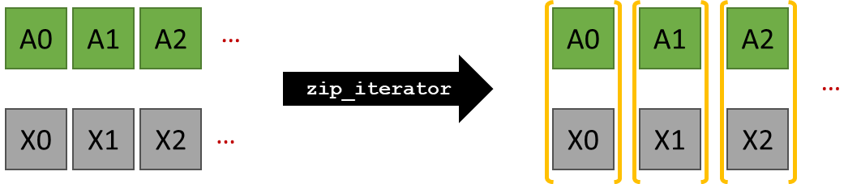
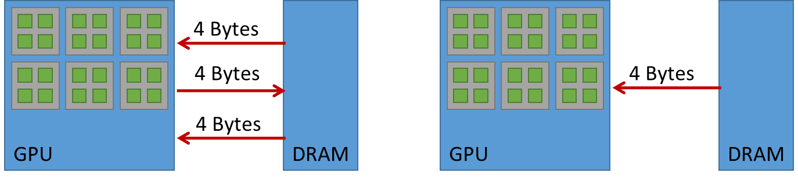
Before we get going…
Last time:
Off-the-shelf GPU computing: thrust
Further discussion, Final Project topics
Today:
CUB
Multi-core parallel computing
Hardware consideration
Getting started with OpenMP
Other tidbits:
ME759 Exam: April 15, at 7:15 PM, in 1106ME
Review: Tu, April 14, at 7:00 PM, in Canvas

Slide 4
GPU Computing with CUB

Slide 5
Hi, my name is CUB!
People know me as CUB, but my real name is “CUDA UnBound”
Currently, I’m at version V1.8.0 (DOB: 02/16/2018)
I’m developed as open-source project by good folks at NVIDIA Research
Primary contributor: Duane Merrill
You can fork me if you want (on GitHub: https://github.com/NVlabs/cub)
Something about me: I can run really, really fast…

Slide 6
CUB, factoids
CUB provides software components at each layer of the CUDA programming model
Like thrust, it’s a headers library, not one binary file that you link against
Implications, given that it’s a header-file library:
When you need to call a function, you need to include the header file that includes the *source* code of the CUB function you want to call
Rationale, header-file library: if the compiler sees the code, it can engage in all sort of optimizations
Inlining, heavy use of templating, compiles for the exact architecture you have, etc.
Fallout: it takes forever to compile
[NVIDIA]$→$

Slide 7
Straight from CUB webpage
Device-wide primitives
Sort, prefix scan, reduction, histogram, etc.
Block-wide “collective” primitives
I/O, sort, prefix scan, reduction, histogram, etc.
Warp-wide “collective” primitives
Warp-wide prefix scan, reduction, etc.
Thread and resource utilities
PTX intrinsics, device reflection, texture-caching iterators, caching memory allocators, etc.
[NVIDIA]$→$

Slide 8
CUB ruminations
The device-wide support is not a novelty, thrust does it too…
thrust built on top of CUB, by the way
The novelty:
You can call CUB from a kernel function that uses the threads in one block to accomplish something
You can call CUB from a kernel function that uses the threads in a warp to accomplish something
The threads in a warp start behaving like the 32 threads of a chip with 32 cores running 32 threads

Slide 9
Reiterating what CUB does [slide hyperlinks should work…]
Parallel primitives
Warp-wide "collective" primitives
Cooperative warp-wide prefix scan, reduction, etc.
Safely specialized for each underlying CUDA architecture
Block-wide "collective" primitives
Cooperative I/O, sort, scan, reduction, histogram, etc.
Compatible with arbitrary thread block sizes and types
Device-wide primitives
Parallel sort, prefix scan, reduction, histogram, etc.
Compatible with CUDA dynamic parallelism
Utilities
Fancy iterators
Thread and thread block I/O
PTX intrinsics
Device, kernel, and storage management
[NVIDIA]$→$

Slide 10

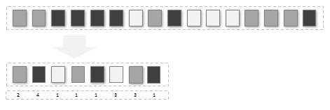

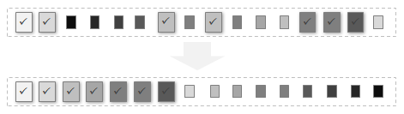
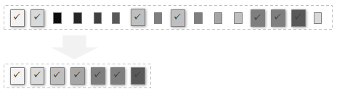

CUB, device-wide operations
You can call these from you C host code:
Histogram
Partition
Radix sort
Reduce
Run length encode
Scan
Select
Sparse matrix-vector multiplications
[NVIDIA]$→$

Slide 11




CUB, block-wide operations [callable from a kernel function]
BlockDiscontinuity class provides collective methods for flagging discontinuities within an ordered set of items partitioned across a CUDA thread block
BlockExchange class provides collective methods for rearranging data partitioned across a CUDA thread block
BlockHistogram
BlockLoad class provides collective data movement methods for loading a linear segment of items from memory into a blocked arrangement across a CUDA thread block
BlockRadixSort class provides collective methods for sorting items partitioned across a CUDA thread block using a radix sorting method
BlockReduce
BlockScan
BlockStore class provides collective data movement methods for writing a blocked arrangement of items partitioned across a CUDA thread block to a linear segment of memory
[NVIDIA]$→$

Slide 12
Example, back of the envelope, for BlockDiscontinuity
#include <cub/cub.cuh>
__global__ void ExampleKernel(...)
{
// Specialize BlockDiscontinuity for a 1D block of 128 threads on type int
typedef cub::BlockDiscontinuity<int, 128> BlockDiscontinuity;
// Allocate shared memory for BlockDiscontinuity
__shared__ typename BlockDiscontinuity::TempStorage temp_storage;
// Obtain a segment of consecutive items that are blocked across threads
int thread_data[4];
...
// Collectively compute head flags for discontinuities in the segment
int head_flags[4];
BlockDiscontinuity(temp_storage).FlagHeads(head_flags, thread_data, cub::Inequality());
First important actor
Second important actor
[https://nvlabs.github.io/cub/classcub_1_1_block_discontinuity.html]$→$

Slide 13
CUB, warp-level primitives
Idea: each warp of threads will work on a chunk of an array and do a scan or reduce on that chunk of the array
WarpScan class provides collective methods for computing a parallel prefix scan of items partitioned across a CUDA thread warp.
WarpReduce class provides collective methods for computing a parallel reduction of items partitioned across a CUDA thread warp.
[NVIDIA]$→$

Slide 14
Example, CUB: sort by key, device-level operation
// device side setup
unsigned int* d_keysIN = NULL;
unsigned int* d_keysOUT = NULL;
pairsOfBodies* d_valsIN = NULL;
pairsOfBodies* d_valsOUT = NULL;
CubDebugExit(g_allocator.DeviceAllocate((void**)& d_keysIN, sizeof(unsigned int) * num_items));
CubDebugExit(g_allocator.DeviceAllocate((void**)& d_keysOUT, sizeof(unsigned int) * num_items));
CubDebugExit(g_allocator.DeviceAllocate((void**)& d_valsIN, sizeof(pairsOfBodies) * num_items));
CubDebugExit(g_allocator.DeviceAllocate((void**)& d_valsOUT, sizeof(pairsOfBodies) * num_items));
// get memory set aside on the device
size_t temp_storage_bytes = 0;
void* d_temp_storage = NULL;
CubDebugExit(DeviceRadixSort::SortPairs(d_temp_storage, temp_storage_bytes, d_keysIN, d_keysOUT, d_valsIN, d_valsOUT, num_items)); // Caching allocator for device memory
CubDebugExit(g_allocator.DeviceAllocate(&d_temp_storage, temp_storage_bytes));
// initialize data on the device
CubDebugExit(cudaMemcpy(d_keysIN, h_keys, sizeof(unsigned int) * num_items, cudaMemcpyHostToDevice));
CubDebugExit(cudaMemcpy(d_valsIN, h_vals, sizeof(pairsOfBodies) * num_items, cudaMemcpyHostToDevice));
// do the actual sort
CubDebugExit(DeviceRadixSort::SortPairs(d_temp_storage, temp_storage_bytes, d_keysIN, d_keysOUT, d_valsIN, d_valsOUT, num_items));
// get data back
CubDebugExit(cudaMemcpy(h_keys_out, d_keysOUT, sizeof(unsigned int) * num_items, cudaMemcpyDeviceToHost));
CubDebugExit(cudaMemcpy(h_vals_out, d_valsOUT, sizeof(pairsOfBodies) * num_items, cudaMemcpyDeviceToHost));
// clean up
if (d_keysIN) CubDebugExit(g_allocator.DeviceFree(d_keysIN));
if (d_keysOUT) CubDebugExit(g_allocator.DeviceFree(d_keysOUT));
if (d_valsIN) CubDebugExit(g_allocator.DeviceFree(d_valsIN));
if (d_valsOUT) CubDebugExit(g_allocator.DeviceFree(d_valsOUT));
if (d_temp_storage) CubDebugExit(g_allocator.DeviceFree(d_temp_storage));
return 0;
}
#define CUB_STDERR // print CUDA runtime errors to console
#include <cub/util_allocator.cuh>
#include <cub/device/device_radix_sort.cuh>
#include "test/test_util.h"
using namespace cub;
// Caching allocator for device memory
CachingDeviceAllocator g_allocator(true);
struct pairsOfBodies {
unsigned int body_I;
unsigned int body_J;
};
int main() {
const unsigned int num_items = 8;
// host side setup
pairsOfBodies h_vals[num_items];
unsigned int h_keys[num_items] = { 2 , 0, 7, 3, 5, 4, 1, 6 };
pairsOfBodies h_vals_out[num_items];
unsigned int h_keys_out[num_items];
h_vals[0].body_I = 3; h_vals[0].body_J = 0;
h_vals[1].body_I = 9; h_vals[1].body_J = 2;
h_vals[2].body_I = 0; h_vals[2].body_J = 9;
h_vals[3].body_I = 2; h_vals[3].body_J = 4;
h_vals[4].body_I = 1; h_vals[4].body_J = 5;
h_vals[5].body_I = 1; h_vals[5].body_J = 7;
h_vals[6].body_I = 2; h_vals[6].body_J = 9;
h_vals[7].body_I = 6; h_vals[7].body_J = 8;

Slide 15
Example, CUB: reduce, device-level operation
#define CUB_STDERR // print CUDA runtime errors to console
#include <stdio.h>
#include <cub/util_allocator.cuh>
#include <cub/device/device_reduce.cuh>
#include "test/test_util.h"
using namespace cub;
CachingDeviceAllocator g_allocator(true); // Caching allocator for device memory
int main() {
const size_t num_items = 10;
// Set up host arrays
int h_in[num_items] = { 2, 3, -1, 0, 3, 6, 7, 2, -2, 0 };
int sum = 0;
for (unsigned int i = 0; i < num_items; i++)
sum += h_in[i];
// Set up device arrays
int* d_in = NULL;
CubDebugExit(g_allocator.DeviceAllocate((void**)& d_in, sizeof(int) * num_items));
// Initialize device input
CubDebugExit(cudaMemcpy(d_in, h_in, sizeof(int) * num_items, cudaMemcpyHostToDevice));
// Setup device output array
int* d_sum = NULL;
CubDebugExit(g_allocator.DeviceAllocate((void**)& d_sum, sizeof(int) * 1));
// Request and allocate temporary storage
void* d_temp_storage = NULL;
size_t temp_storage_bytes = 0;
CubDebugExit(DeviceReduce::Sum(d_temp_storage, temp_storage_bytes, d_in, d_sum, num_items));
CubDebugExit(g_allocator.DeviceAllocate(&d_temp_storage, temp_storage_bytes));
// Do the actual reduce operation
CubDebugExit(DeviceReduce::Sum(d_temp_storage, temp_storage_bytes, d_in, d_sum, num_items));
int gpu_sum;
CubDebugExit(cudaMemcpy(&gpu_sum, d_sum, sizeof(int) * 1, cudaMemcpyDeviceToHost));
// Check for correctness
printf("\t%s\n", (gpu_sum == sum ? "Test passed." : "Test falied."));
printf("\tSum is: %d\n", gpu_sum);
// Cleanup
if (d_in) CubDebugExit(g_allocator.DeviceFree(d_in));
if (d_sum) CubDebugExit(g_allocator.DeviceFree(d_sum));
if (d_temp_storage) CubDebugExit(g_allocator.DeviceFree(d_temp_storage));
return 0;
}

Slide 16
CUB, departing thoughts
CUB is not the friendliest library to use, and the documentation is both dense and limited
CUB provides amazing performance
Use it when you start processing big data
It’s worth spending the time to make friends with CUB
We use CUB in the lab

Slide 17
Multi-core parallel computing with OpenMP

Slide 18
Opportunities for Efficiency Gains
Cluster (distributed mem.)
Group of nodes communicate through fast interconnect
MPI, Charm++, Chapel
Multi-Socket Node
Group of CPUs on the same node, talk through main mem.
OpenACC, OpenMP, MPI
Acceleration (GPU/Phi)
Compute devices accelerating parallel computation on one node
CUDA, OpenCL, OpenMP, OpenACC
Multi-Core Processor
Communication through shared caches and main mem.
OpenMP, TBB, pthreads, OpenACC
Vectorization
Higher operation throughput via special/fat registers
AVX, SSE, OpenMP
Pipelining
Sequence of instruction sharing functional units
Assembly
Superscalar
Non-sequence instructions sharing functional units
Assembly
We have full control →
We have little to no control →
Any pipeline issues that we can address?
Do the threads work together harmoniously? Any NUMA issues to be aware of?
Hitting the cache?
Any opportunities for SIMD? Use GPU or AVX?
Communication/synchronization reduced as much as possible?

Slide 19
OpenMP: Step #1 – Know your hardware

Slide 20
Feature Length on a Chip: Moore’s Law at Work
2013 – 22 nm
2015 – 14 nm
2017 – 10 nm
2019 – 7 nm
2021 – 5 nm
2023 – 3 nm (Samsung?)

Slide 21

Implications
One can take this in two directions
Keep the number of transistors constant on a chip, but decrease its size (by a factor of $\sqrt{2}$), or
Keep size constant, but increase computational power and/or smarts of the chip by adding more transistors

Slide 22
Keeping the Transistor Count Constant
A 12 cores chip, which was top of line in 2013, how much space will it take in the future?
Back of the envelope numbers
Size of chip – assume a square of length “L”
2013: L about 20 mm
2015: L ≈ 14 mm
2017: L ≈ 10 mm
2019: L ≈ 7 mm
2021: L ≈ 5 mm → a fifth of an inch fits on your phone

Slide 23
Keeping the Area Constant
October 2015:
Intel Xeon w/ 18 cores – 5.7 billion transistors (E7-8890 v3, $7200)
June 2017:
AMD EPYC – 32 cores, 19.2 billion transistors (EPYC 7601, $4,200)
February 2020:
AMD Ryzen™ Threadripper™ 3990X – 64 cores, 39.54 billion transistors, 288MB of cache, 7nm, $3990

Slide 24
Illustrating Hardware, OpenMP
Intel Haswell
Released in June 2013
22 nm technology
Transistor budget: 1.4 billions
Tri-gate, 3D transistors
Typically comes in four cores
Has an integrated GPU
Deep pipeline – 16 stages
Sophisticated infrastructure for ILP acceleration
Superscalar
Supports HTT
Good source of information for these slides: http://www.realworldtech.com/

Slide 25
General Schematic, Haswell
Core 0
Core 1
Core 2
Core 3
L1 and L2 are per-core
(data hazards: RAW, WAW, etc.)
L1 Cache
L2 Cache
L1 Cache
L2 Cache
L1 Cache
L2 Cache
L1 Cache
L2 Cache
The Haswell Chip

Slide 26
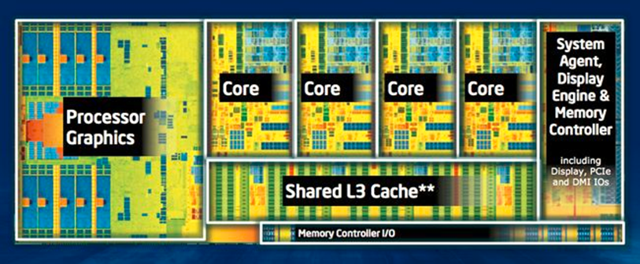
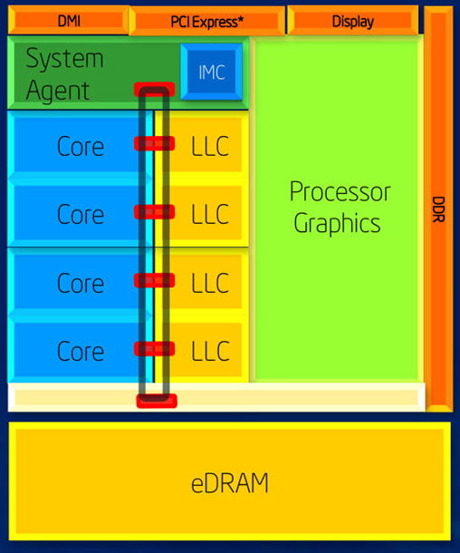
Illustrating Hardware, Haswell
Actual layout of the chip:
Schematic of the chip organization
LLC: last level cache (L3)
Three clocks:
A core’s clock ticks at 2.7 to 3.0 GHz but adjustable up to 3.7-3.9 GHz
Graphics processor ticking at 400 MHz but adjustable up to 1.3 GHz
Ring bus and shared L3 cache - a frequency that is close to but not necessarily identical to that of the cores

Slide 27
Caches
Data:
L1 – 32 KB per core
L2 – 512 KB or 1024 KB per core
L3 – 8 MB per CPU
This is LLC – last level cache for this chip
Instruction:
L0 – room for about 1500 microoperations (uops) per core
L1 – 32 KB per core
Cache is a black hole for transistors
Example: 8 MB of L3 translates into:
8*1024*1024*8 (bits) * 6 (transistors per bit, SRAM) = 402 million transistors out of 1.4 billions

Slide 28
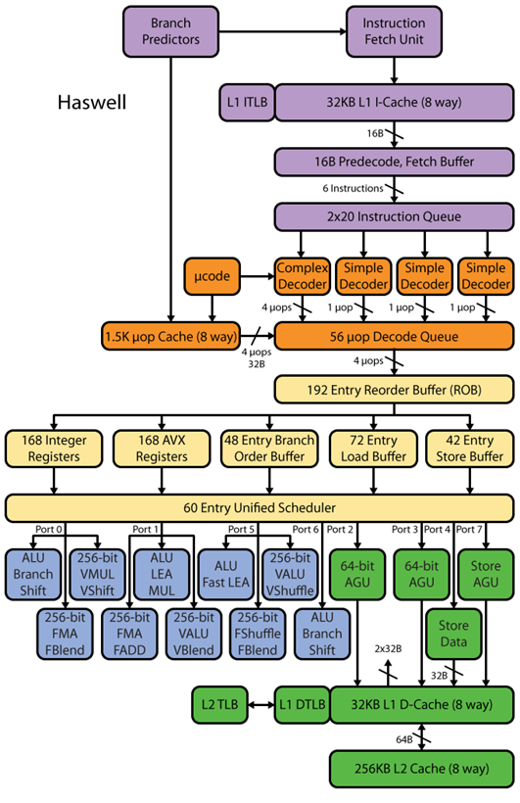
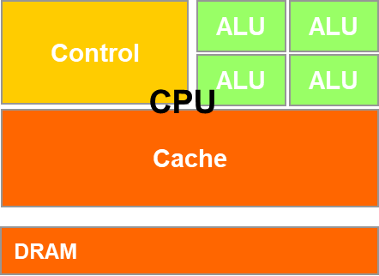
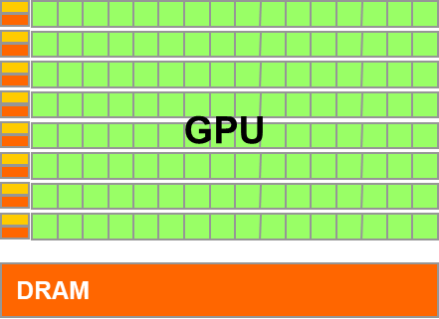
Haswell Microarchitecture [30,000 Feet]
Microarchitecture components:
Instruction pre-fetch support (purple)
Instruction decoding support (orange)
CISC into uops
Can be regarded as CISC to RISC step
Instruction Scheduling support (yellowish)
Instruction execution
Arithmetic (blueish)
Memory related (green)
Control-side
ALU-side
[http://www.realworldtech.com]→
Notes:
LEA: Load effective address
The address generation unit (AGU), sometimes also called address computation unit (ACU), is an execution unit inside central processing units (CPUs) that calculates addresses used by the CPU to access main memory.

Slide 29
Moving from HW to SW

Slide 30
Acknowledgements
Many OpenMP slides are from Intel’s library of OpenMP presentations
Slides used with permission
Credit given where due: IOMPP
IOMPP stands for “Intel OpenMP Presentation”
Several code examples originate in the Microsoft’s Developer Network (MSDN) collection of OpenMP code snippets
Other slides contain input from various sites on the internet
I tried whenever possible to give credit where due
Apologies for omitting any source

Slide 31
OpenMP: When Used
CUDA: targeted parallelism on the GPU
OpenMP: targets parallelism on SMP architectures
Handy when
You have a multi-core processor, say 16 cores/socket
Might have multiple sockets, say 2
You have a good amount of system memory, say 64 GB
MPI: targeted parallelism on a cluster (distributed computing)
Note that MPI implementation can handle transparently an SMP architecture such as a workstation with two hexcore CPUs that draw on a good amount of shared memory

Slide 32
process vs. thread
How similar: Both processes and threads are independent sequences of execution
How different:
Threads (of the same process) run in a shared memory space
However, each thread has its own PC
Who draws on it: OpenMP
Processes run in separate memory spaces
Each process has its
Who draws on it: MPI

Slide 33
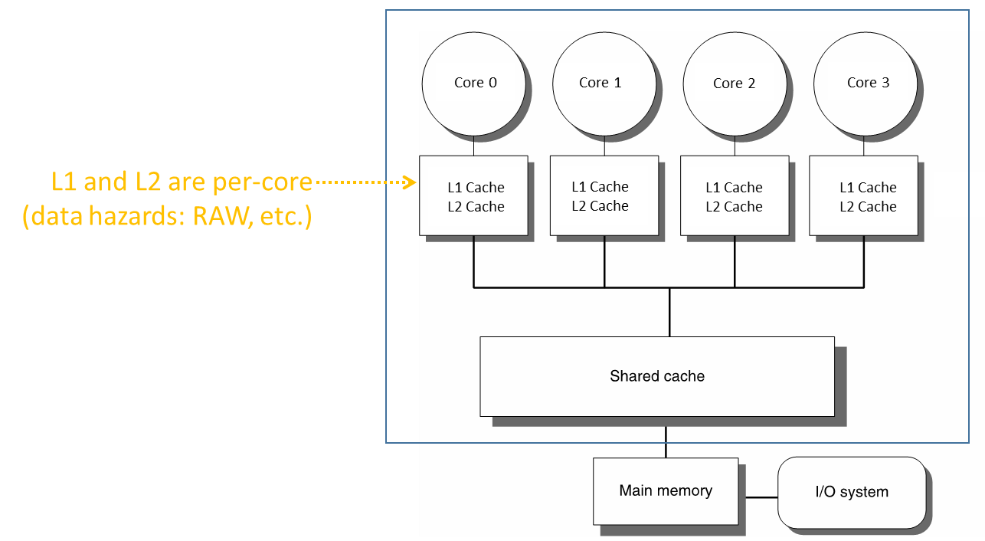
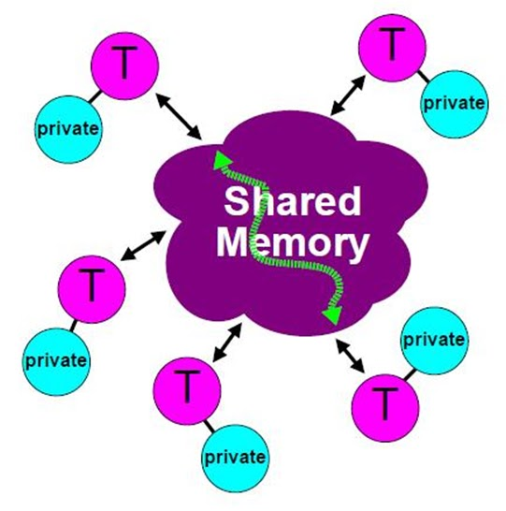
OpenMP Attributes
Parallel execution of multiple tasks via multiple threads
Threads have access to a pool of memory that is shared
Threads can have private data
Not accessible by other threads
When/How data is written/read from memory is transparent to programmer
However, programmer has some control (atomic, flush, etc.)
Synchronization in thread execution is implicit but can be made explicit as well
[CodeProject]→

Slide 34
OpenMP: What’s Reasonable to Expect
If you have more than 16 cores or so in an SMP setup, it’s unlikely that you can get a speed-up on that scale. All sorts of overheads kick in to slow you down
Beyond 16: law of diminishing return
Some of the reasons for lack of scaling:
Cache coherence (more in a couple of lectures)
False cache sharing (more in a couple of lectures)
No over-commitment of hardware (recall CUDA/GPU computing and over-subscription of the SM hardware assets)
Notes:
Nice discussion of HTT: https://software.intel.com/en-us/articles/performance-insights-to-intel-hyper-threading-technology

Slide 35
Data vs. Task Parallelism
Data parallelism
You have a large amount of data elements and each data element needs to be processed to produce a result
When this processing can be done in parallel, we have data parallelism
Example:
Adding two long arrays of doubles to produce yet another array of doubles
Task parallelism
You have a collection of tasks that need to be completed
Task parallelism: these tasks can be performed in parallel
Example, task parallelism:
Prepare a soup, make a salad, bake a cake, microwave popcorn

Slide 36
Objectives, ME759
Understand OpenMP at the level where you can
Implement data parallelism
Implement task parallelism
Notes:
Script:
The objectives of the course are to prepare students and faculty to use OpenMP to parallelize C, C++, Fortran applications using either task or data parallelism. The course is expected to take 2 hours for the lecture – plus additional time for the labs or demos up to about an hour

Slide 37
OpenMP: What Is It?
Portable programming environment that invokes at run-time a shared-memory multi-threading execution of the code
Language bindings: Fortran, C, and C++
Multi-vendor support for both Linux and Windows
Alternative to using posix threads
Standardizes task & loop-level parallelism
Combines serial and parallel code in single source
[IOMPP]→
Notes:
Script:
What is OpenMP?
OpenMP is a portable (OpenMP codes can be moved between linux & windows for example), shared-memory threading API that standardizes task & loop level parallelism. Because OpenMP clauses have both lexical and dynamic extent, it is possible support a broad multi-file course grained parallelism. Often, the best parallelism technique is to parallel at the coarsest grain possible often parallelizing tasks or loops from with the main driver itself – as this gives the most bang for the buck (the most computation for the necessary threading overhead costs).
Another key benefits is that OpenMP allows for a developer to parallelize their applications incrementally. Since OpenMP is primarily a pragma or directive based approach we can easily combine serial & parallel code in a single source. By simply compiling with or without the /OpenMP compiler flag we can turn OpenMP on or off. Code compiled without the /OpenMP flag simply ignores the OpenMp pragmas which allows simple access back to the original serial application.
Openmp also standardizes about 20 years of compiler directed threading experience.
For more information or to review the latest OpenMP spec (currently the latest spec is OpenMP 3.0) – goto www.openmp.org

Slide 38
OpenMP Mission Statement
“Standardize directive-based multi-language high-level parallelism that is performant, productive and portable.”

Slide 39
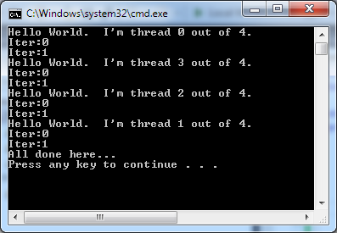
Example: Hello World
#include <stdio.h>
#include <omp.h>
int main() {
#pragma omp parallel
{
int myId = omp_get_thread_num();
int nThreads = omp_get_num_threads();
printf("Hello World. I'm thread %d out of %d.\n", myId, nThreads);
for( int i=0; i<2 ;i++ )
printf("Iter:%d\n",i);
}
printf(“All done here…\n");
}
Here’s a two core laptop, with HTT:
Intel Core i5-3210M @ 2.50GHz 3 MB L3 Cache, TDP 35 Watts, Two-Core Four-Thread Processors
Notes:
Script:
Take about 5 minutes to build and run the hello world lab. In this example – we will print “hello world” from several threads. Run the code several times. Do you see any issues with the code – do you always get expected results? Does anyone in the class have weird behavior in terms of the sequence of the words that are printed out?
Since printf is a function of state – it can only print one thing to one screen at a time – some students are likely to see “race conditions” where one printf in a thread is writing over the results of another printf in an other thread.

Slide 40
Comments, “Hello World!” Example
OMP parallel region on previous slide just like a CUDA kernel
Each CUDA thread executes the kernel
In OpenMP, each thread executes the parallel region
Important difference:
Variables inside GPU kernel are truly local variables, stored in registers
OMP variables in a parallel region may or may not be visible to other threads executing the code of the parallel region
Scoping of a variable in OpenMP is tricky
Discussed later
An OpenMP structured block that marks a “parallel region” is rarely used like a kernel is in GPU computing
Most often, used in a different context (such as for work sharing, more to come)

Slide 41
OpenMP: Historical Perspective
Very good at coarse-grained, task parallelism
Current spec is OpenMP 5.0
Released in November 2018, http://www.openmp.org
More than 600 Pages
Not yet implemented by any compiler
Not all compilers are equally up-to-date w/ the standard
GNU compiler supports up to OpenMP 4.5 , but does not fully support GPU offloading
IBM XL compiler up to speed
llvm compiler supports 3.1 with some 4.0 and 4.5 features
Microsoft compiler lagging behind (Version 2.0 as of March 2020)
[IOMPP]→
Notes:
Script:
What is OpenMP?
OpenMP is a portable (OpenMP codes can be moved between linux & windows for example), shared-memory threading API that standardizes task & loop level parallelism. Because OpenMP clauses have both lexical and dynamic extent, it is possible support a broad multi-file course grained parallelism. Often, the best parallelism technique is to parallel at the coarsest grain possible often parallelizing tasks or loops from with the main driver itself – as this gives the most bang for the buck (the most computation for the necessary threading overhead costs).
Another key benefits is that OpenMP allows for a developer to parallelize their applications incrementally. Since OpenMP is primarily a pragma or directive based approach we can easily combine serial & parallel code in a single source. By simply compiling with or without the /OpenMP compiler flag we can turn OpenMP on or off. Code compiled without the /OpenMP flag simply ignores the OpenMp pragmas which allows simple access back to the original serial application.
Openmp also standardizes about 20 years of compiler directed threading experience.
For more information or to review the latest OpenMP spec (currently the latest spec is OpenMP 3.0) – goto www.openmp.org

Slide 42
OpenMP Programming Model
Master thread spawns a team of threads as needed
Managed transparently on your behalf
Relies on low-level thread fork/join methodology to implement parallelism
The developer is spared the details
Straightforward to ease into the use of OpenMP
Parallelism is added incrementally
The sequential program evolves into a parallel program
[IOMPP]→
Notes:
Script:
OpenMP uses a fork join methodology to implement parallelism. A master thread, shown in red, begins executing code. At an OMP PARALLEL directive, the master thread forks other threads to do work. At a specified point in the code called a barrier, the master thread will wait for all the child threads to finish work before proceeding. Because we can have multiple parallel regions each created as above, we see that parallelism can be added incrementally. We can work on one region of code and get it running well as a parallel region and we can simply turn off openmp in other more problematic parallel regions, until we get the desired program behaviour.
That’s the high level overview of OpenMP, now we will look at some of the details to get us started.
More Background info:
In case someone asks if the threads are really created and destroyed between parallel regions – here is some background info:
The Intel OpenMP implementation maintains a thread pool to minimize overhead from thread creation. Worker threads are reused from one parallel region to the next. In serial regions, the worker threads either sleep, spin, or spin for a user-specified amount of time before going to sleep. This behavior is controlled by the KMP_BLOCKTIME environment variable or the KMP_SET_BLOCKTIME function, which are described in the compiler documentation. Worker thread behavior in the serial regions can affect application performance. On shared systems, for example, spinning threads consume CPU resources that could be used by other applications. However, there is overhead associated with waking sleeping threads.

Slide 43
OpenMP Execution Model
A small window into the execution flow of an OpenMP program
Sequential execution regions
F o r k
Join
F o r k
J o i n
F o r k
J o i n
Fork
Join
Another parallel region
A parallel region
Yet another parallel region
Master thread
Slave thread

Slide 44
OpenMP, Compiling Using the Command Line
Method depends on compiler
GCC:
ICC:
MSVC:
$ gcc -o integrate_omp integrate_omp.c –fopenmp
$ icc -o integrate_omp integrate_omp.c –openmp
$ cl /openmp integrate_omp.c

Slide 45
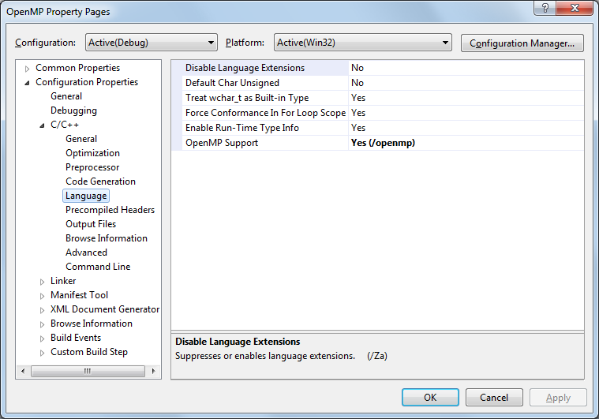
Visual Studio Specific
Step 2:
Select /openmp
Step 1:
Go here

Slide 46
Example: Calculate Entries in a Table
Version 0: Fill up the table, use a for loop to visit each entry
#include <math.h>
int main()
{
const int size = 256;
double sinTable[size]; // sin table to be initialized
for (int n = 0; n<size; ++n)
sinTable[n] = sin(2 * M_PI * n / size);
// the table is now initialized
}

Slide 47
Example: Calculate Entries in a Table in Parallel w/ OpenMP
Version 1:
What gets used most of the time
#include "omp.h"
#include <math.h>
int main()
{
const int size = 256;
double sinTable[size]; // sin table to be initialized
#pragma omp parallel for
for (int n = 0; n<size; ++n)
sinTable[n] = sin(2 * M_PI * n / size);
// the table is now initialized
}
[ http://bisqwit.iki.fi/story/howto/openmp/ ]→

Slide 48
Example: Calculate Entries in a Table in Parallel w/ OpenMP
Version 2:
Uses wide registers & vector operations (CPU needs to have special chops to support this)
Not supported by MS compiler
#include "omp.h"
#include <math.h>
int main()
{
const int size = 256;
double sinTable[size]; // sin table to be initialized
#pragma omp simd
for (int n = 0; n<size; ++n)
sinTable[n] = sin(2 * M_PI * n / size);
// the table is now initialized
}
[ http://bisqwit.iki.fi/story/howto/openmp/ ]→

Slide 49
Example: Calculate Entries in a Table in Parallel w/ OpenMP
Version 3:
Offloading code to different devices, such as a GPU
Not supported by MS compiler
#include "omp.h"
#include <math.h>
int main()
{
const int size = 256;
double sinTable[size]; // sin table to be initialized
#pragma omp target teams distribute parallel for map(from:sinTable[0:256])
for (int n = 0; n<size; ++n)
sinTable[n] = sin(2 * M_PI * n / size);
// the table is now initialized
}
[ http://bisqwit.iki.fi/story/howto/openmp/ ]→

Slide 50
A Few Syntax Details to Get Started
Picking up the OpenMP header file
#include “omp.h” (for C/C++)
use omp_lib (for FORTRAN)
Most OpenMP constructs are compiler directives
C and C++: the directives take the form of pragmas:
#pragma omp construct [clause [clause]…]
Fortran: the directives take one of the forms:
C$OMP construct [clause [clause]…]
!$OMP construct [clause [clause]…]
*$OMP construct [clause [clause]…]
[IOMPP]→
Notes:
Script:
Most of the constructs we will looking at in OpenMP are compiler directives or pragmas.
The C/C++ and Fortran versions of these directives are shown here.
C and C++, the pragmas take the form:
#pragma omp construct [clause [clause] where clauses are optional modifiers
Be sure to include “omp.h” if you intend to use any routines from the OpenMP Library.
Now let look at some environment variables that control OpenMP behavior
Note to Fortran Users:
For Fortran, you can also use other sentinel’s (!$OMP), but these must exactly line up on columns 1-5. Column 6 must be blank or contain a + indicating that this line is a continuation from the previous line.

Slide 51
Why Compiler Directives?
A code design principle nurtured by OpenMP:
The same code, with no modifications, can run with or without OpenMP
Accounts for the case when the OpenMP runtime is not available or not used
Implications: you have to “hide” all the compiler directives behind pragmas (comments, in Fortran)
Directives are picked up by the compiler only if instructed to do so
Example: Visual Studio – you have to have the /openmp flag on

